Slide 1
Mechanics & Application to human body
Dr. Preeti Ganachari
Dept. Of Neurophysiotherapy
Mgm Institute Of Physiotherapy
Chh. Sambhajinagar

Slide 2
Learning Objective
Mechanics
Biomechanics
Kinematics
Kinetics

Slide 3
Mechanics
Mechanics is a branch of science that deals with forces and the effects produced by these forces

Slide 5
Biomechanics
The application of this science to the biological system is referred to as biomechanics
Human biomechanics focuses on how forces act on the musculoskeletal system and how the body tissue responds to these forces

Slide 6
Using the forces involved in the production of movement and posture,
External biomechanics describes external forces on body segment and their effect on body movement
Internal biomechanics are forces generated by the body tissues and their effect on movement. "This includes the muscle forces and the forces in bones and joints that result from transmission of the muscle forces through the skeleton"

Slide 7
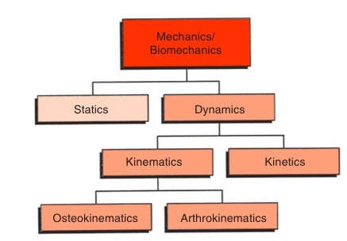
Domains of Mechanics
Static is a branch of mechanics that analyse the bodies at rest or uniform motion
Dynamics deals with the study of conditions under which an object moves

Slide 8
Kinetics concept deal with body motion and the force that cause it to move
Kinematics describes body motion without regard to the forces that produce that motion. In kinematic, there are five variables of interest: type of motion or displacement, the location, the direction, the magnitude and the rate of the motion or displacement

Slide 9
Kinematic variables
Type of motion
Human motion is described as general motion i.e a complex combination of linear and angular components of motion
And most of the time, human motion is analyzed as either linear or angular motion as these two types of motion are basically considered “pure” motion

Slide 10
Linear motion
Linear motion is also known as translatory or translational motion
In linear motion, all parts of the body are moving in the same direction and at the same speed and if this motion occurs along a straight line it is referred to as linear
Curvilinear motion is when motion occurs along a curved path

Slide 11
Angular motion
Angular motion is described as a rotation that occurs around a central imaginary line known as the rotation axis

Slide 12
Magnitude of motion
Angular motion: radians or degree (Goniometer)
Linear motion: (linear distance covered by an object (6-minute walk test)

Slide 13
Rate of motion
Speed or velocity is used to measure the rate of motion and change in velocity is acceleration

Slide 14
Location of joint motion in space
Axes and planes

Slide 15
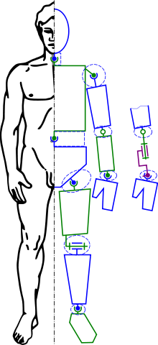
Kinematic chain
Combination of degree of freedom forms kinematics chain and kinematics chain can be open or closed
Open chain: One joint can move independently of others
Closed chain: One end of chain remains fixed

Slide 16
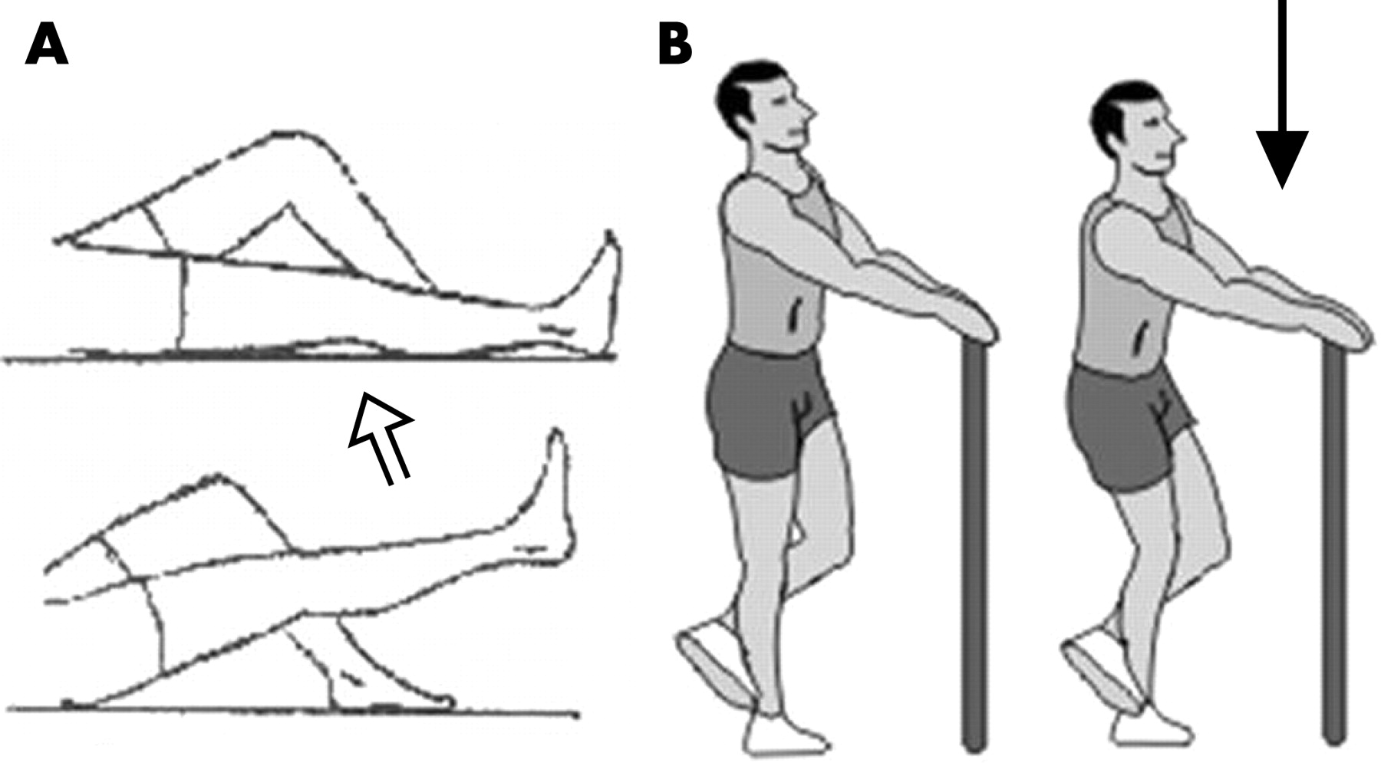

Slide 17
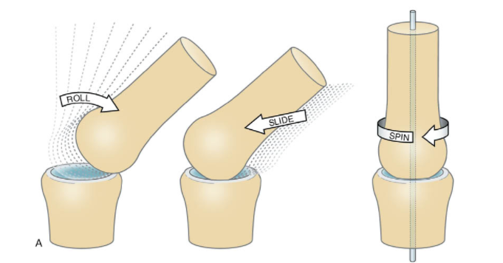
Arthrokinematics
It refers to the movement of joint surfaces
The angular movement of bones in the human body occurs as a result of a combination of rolls, spins, and slides

Slide 18
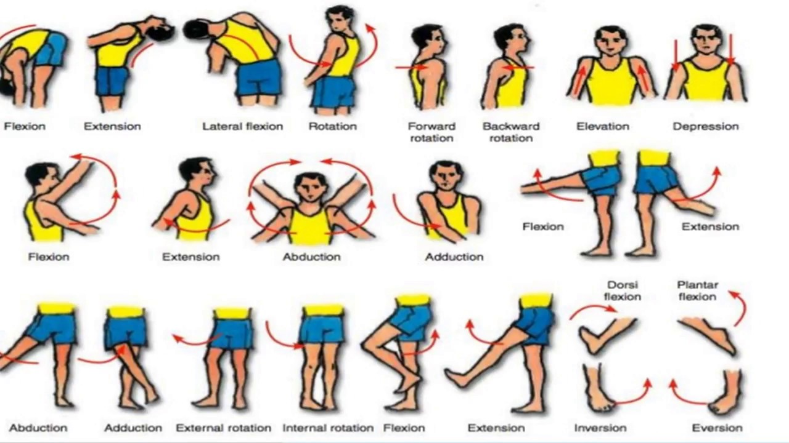
Osteokinematics
The branch of biomechanics concerned with the description of bone movement when a bone swings through a range of motion around the axis in a joint, such as with flexion, extension, abduction, adduction, or rotation

Slide 20
Anatomical terms

Slide 21
Anatomical position

Slide 31
Axes and Planes

Slide 32
Planes
A plane is an imaginary flat surface running through the body

Slide 33
A sagittal plane, also known as the longitudinal plane, is perpendicular to the ground and divides the body into left and right
The midsagittal or median plane is in the midline i.e. it would pass through the midline structures (e.g. navel or spine), and all other sagittal planes (also referred to as parasagittal planes) are parallel to it

Slide 35
A coronal or frontal plane is perpendicular to the ground and divides the body into dorsal (posterior or back) and ventral (anterior or front) portions.

Slide 37
A transverse plane, also known as an axial plane or cross-section, divides the body into cranial (head) and caudal (tail) portions
It is parallel to the ground, which (in humans) separates the superior from the inferior, or put another way, the head from the feet

Slide 39
Axes
An axis is a straight line around which an object rotates
Movement at the joint takes place in a plane about an axis
There are three axes of rotation

Slide 40
Sagittal axis - passes horizontally from posterior to anterior and is formed by the intersection of the sagittal and transverse planes

Slide 41
Frontal axis - passes horizontally from left to right and is formed by the intersection of the frontal and transverse planes

Slide 42
Vertical axis - passes vertically from inferior to superior and is formed by the intersection of the sagittal and frontal planes

Slide 46
Description of movements
Extension occurs when the angle between two adjacent segments in the body increases as the ventral surfaces of the segments move away from each other and occurs in a sagittal plane about a frontal axis
An exception is extension of the thumb, which takes place in a frontal plane about a sagittal axis

Slide 47
Flexion occurs when the angle between two adjacent segments in the body decreases as the ventral surfaces of the segments approximate each other and occurs in a sagittal plane about a frontal axis
An exception is flexion of the thumb, which takes place in a frontal plane about a sagittal axis

Slide 49
Abduction/Adduction:
These are movements in the frontal plane about the sagittal axis and involve moving the body part away or towards an imaginary centre line
Abduction is taking the body part away from the central line and adduction is moving it towards
Adduction can also be moving the body part across the centre line and to the other side of the body, shown in the hip abduction image

Slide 50
Amongst the joints capable of abduction and adduction are the shoulder and hip. Other abduction and adduction movements include the fingers. If you splay your fingers and move them apart, this is abduction as they are moving away from the centre position. When you bring the fingers back together, this is adduction, as you are adding them back to the centre line

Slide 52
Rotation movements are in the transverse plane and vertical axis include any twisting motion. Joints which permit rotation include the shoulder and hip. These are both ball and socket joints
We can also rotate our necks and backs due to a series of smaller joints, including the atlantoaxial joint which is a pivot joint in the neck between the first two vertebrae (C1 and C2)
Rotation of the hip and shoulder can be broken down into internal or external rotation (also sometimes known as medial and lateral rotation respectively)

Slide 55
Mechanics of Motion

Slide 56
Laws of Motion
Law of Inertia: An object in motion will tend to stay in motion or at rest will tend to stay so unless acted upon by a force
Law of Acceleration: The acceleration (tendency of an object to change speed or direction) an object experiences is proportional to the size of the force and inversely proportional to the object’s mass (F = ma)
Law of Reaction: The Third Law states that for every action (force) there is an equal and opposite reaction force

Slide 58
Gravity
A force by which all bodies that are attracted to the earth
The gravitational attraction of the earth for every other body is directed towards the earth’s centre
Force of gravity acts continuously upon the human body, if unopposed the latter will fall to the ground
The effects of gravity can be counter balanced- support of plinth, buoyancy of water, muscular contraction
If force is greater, movement will occur in the direction of force

Slide 59
Centre of Gravity
COG of a rigid body is the point through which the earth’s attraction effectively acts whatever the position of the body, i.e. the point through which the line of action of the weight acts
A rigid body will balance when it is supported only at its centre of gravity
A uniform rod
Irregular piece of cardboard

Slide 60
COG in human body- Body of second sacral vertebra
Higher in men and children > women
As the position changes the COG alters

Slide 61
Line of Gravity
Line of gravity is a vertical line through the centre of gravity
Fundamental standing position: LOG passes through the body of S2 through the vertex, between the feet at the level of transverse tarsal joint
LOG alters according to the position
When posture is good, LOG passes through mid-cervical, mid-lumbar vertebrae and in front of thoracic vertebrae

Slide 62
Base
The base, as applied to a rigid body, is the area by which it is supported
Cube: part on which it rests
Chair: area bounded by the lines joining the legs
In the lying position: posterior aspect of the whole body Stride sitting/standing: base is the area as wide as the feet

Slide 63
Equilibrium
Equilibrium results when the forces acting upon a body are perfectly balances and the body remains at rest

Slide 64
Stable equilibrium:
If the forces acting upon a body at rest tend to restore it to its original position after it has been displaced, the body is said to be in stable equilibrium
Stability is maximum- Centre of gravity (COG) is at the lowest, Line of gravity (LOG) is within and at the centre of a large base of support (BOS)
Instability increases as COG raises, LOG falls near the margin of a smaller base

Slide 65
Unstable equilibrium:
If a body is given an initial displacement and the force acting upon it increase this initial displacement, however small the latter may be, the body is said to be in an unstable equilibrium
A COG at the highest, a small base, LOG falling at the margin or outside the BOS- relatively unstable equilibrium
Eg. Toe standing

Slide 66
Neutral equilibrium:
IF, in spite of displacement of a body, the height and position of its centre of gravity remain in the same in relation to the base, the body is said to be in a neutral equilibrium
Eg. Ball rolling on a planar surface

Slide 67
Greatest stability in lying position

Slide 69
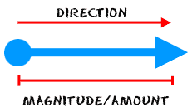
Force
Force is that which alters the state of rest of a body or its uniform motion in a straight line
Composition of forces,
(i) The direction of the force; represented by an arrow
(ii) The magnitude of the force; represented by length of an arrow
A single force applied to a body, which is free to move, causes movement in the direction of the force

Slide 70
Two forces acting in the same direction and at a common point are equivalent to a single force acting in that direction, whose magnitude is equal to the sum of the magnitudes of the individual forces
F1 & F2
F3= F1 + F2
F3

Slide 71
Two equal forces acting at a common point, and in opposite directions, will result in a state of equilibrium
F1
F2

Slide 72
Two unequal forces acting at a common point and in opposite directions will result in movement in direction of the greater force, the magnitude of the force producing this movement being equal to the difference between the magnitudes of the two unequal forces which oppose each other
F1
F2
F1= 10 N
F2= 5 N

Slide 73
Much of our work involves the application of forces to oppose, equal or augment the forces of muscle action and of gravity

Slide 74
Two forces acting at an angle to each other may be compounded to produce the desired effect
Two forces, AB and AC act at A. Diagonal AX of the parallelogram ABXC represents resultant equivalent forces
B
A
X
C

Slide 75
Two unequal forces acting at different points and in opposite directions produce rotation of the body

Slide 76
Speed
The rate at which a body moves, and takes no account of the direction
m/s
Uniform speed along the straight road
Variable speed along the curve and then a straight line
Relaxed Passive Movements:
Slow and Uniform

Slide 77
Active exercises
Natural Speed
Reduced Speed
Active Speed

Slide 78
Velocity
The notion of velocity incorporates not just the rate of motion but also the direction
The velocity of an object is the rate of change of its position with respect to a frame of reference, and is a function of time
A change in either speed or direction, alters velocity

Slide 79
Work
It is the product of force and the distance through which the force acts
Work is said to be done on an object when a force causes a displacement of the object
Joules/ergs

Slide 80
Energy
The capacity of a body for doing work
Potential energy
Capacity of doing work by virtue of its position
Kinetic energy
Capacity of doing work by virtue of its velocity

Slide 81
Power
It is the rate of doing work or the rate of energy expenditure
Joules/sec
ergs/sec

Slide 82
Acceleration
It is the rate of change of velocity
Increase in Velocity- Acceleration
Decrease in Velocity- Deceleration/ retardation
All bodies, irrespective of their weight, are subject to the same uniform acceleration as they fall freely under gravity

Slide 83
Momentum
The quantity of motion a body possesses is momentum
Mass x velocity
Force responsible for momentum will generate movement slowly in heavy body and relatively rapidly in lighter body

Slide 84
Inertia
Resistance of a body towards any change in its state of rest or motion
Reverse effective force of a body
Once inertia of the body has been overcome and movement is initiated,
more economical to continue moving
More force is required to overcome the inertia on stopping, starting or altering speed

Slide 86
Friction
A force that opposes motion when one surface slides upon another, a force sufficient to prevent movement altogether
Dynamic friction- Frictional resistance obtained during movement
Limiting friction- Frictional resistance obtained just when the sliding is about to set in
Frictional resistance < Limiting resistance

Slide 87
Dynamic friction of a moving limb can be further reduced when the latter is supported by a plane surface/ polished surface (table/plinth) on which table will slide
Use talcum powder/oil
Increased friction plays an important role in safety measures
eg. Non-slip floors in gymnasia, slopes, stairs, non-slip footwear, rubber ferrules on walking aids

Slide 88
Simple machines

Slide 89
A machine is a contrivance which enables an applied force to overcome a given resistance
Machines help the force which is applied to overcome resistance or enables the application of force more convenient

Slide 90
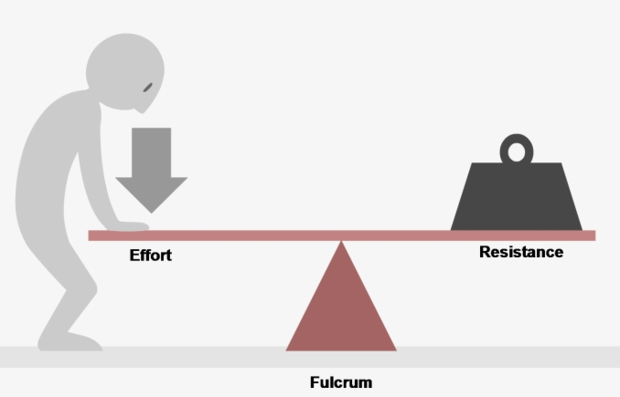
Levers
Lever: A rigid bar capable of movement about a fixed point called fulcrum (F)
Work is done when a force or effort (E) applied at one point on the lever, acts upon another force or weight (W) acting at a second point on the lever
Effort’s arm: The perpendicular distance from the fulcrum to the effort (E)
Weight’s arm: The perpendicular distance from the fulcrum to the weight (W)

Slide 91
In the body,
Lever – bone
Fulcrum - Articulating joint surfaces
Effort – Force of muscular contraction
Weight – The object to be lifted
3 orders of levers depending on the relative positions of fulcrum, effort and weight

Slide 92
1st Order lever:
The fulcrum is between effort and weight. It may be situated centrally, or towards either the effort or the weight, consequently the effort’s and the weight’s arms may be equal or one may exceed the other in length
W
E
W
E
W
E
F
F
F
(1a)
(1b)
(1c)

Slide 93
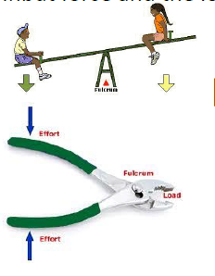
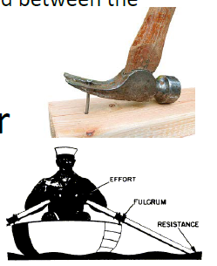

Slide 94
2nd Order lever
The weight is between the fulcrum and the effort, and the effort’s arm will therefore always exceed the weight’s arm
F
E
W
(2)

Slide 95
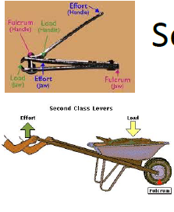
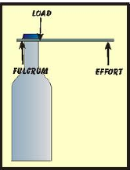
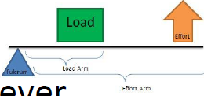

Slide 96
3rd Order Lever:
The effort is between the fulcrum and the weight, and the weight’s arm will therefore exceed the effort’s arm
F
W
E
(3)

Slide 97
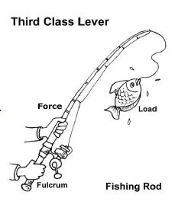
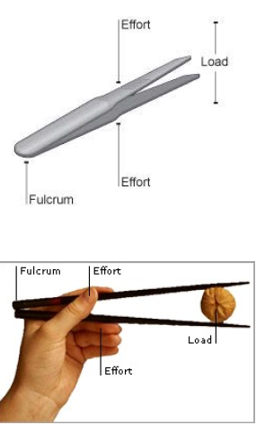
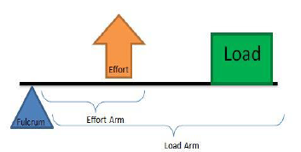

Slide 98
Mechanical Advantage:
The efficacy of force in relation to a lever is dependent upon 2 factors,
(i) Fore exerted (W) or (E)
(ii) Perpendicular distance from the fulcrum (Weight’s arm or effort’s arm)
Product of these two factors is known as Moment of Force (Torque)

Slide 99
When the weight’s arm = effort’s arm i.e. they are of equal length, an effort of a magnitude equal to that of the weight will be required to lift it
No advantage is gained but the machine is useful for measuring weights, eg. In common balance

Slide 100
If however, the length of the effort’s arm exceeds that of the weight’s arm, less effort will be required to achieve a similar result and an advantage will be gained by the use of the lever
This is known as mechanical advantage, is obtained in levers of 1st order (when fulcrum is nearer to the weight) and in all the 2nd order levers

Slide 102
Conversely, when the weight’s arm exceeds the effort’s arm, a condition of mechanical Disadvantage occurs, as in levers of 1st Order, when fulcrum is nearer to the effort than to the weight and n all the 3rd order levers

Slide 103
Levers of the Body
1st Order:
Feature: Stability and a state of equilibrium with or without mechanical advantage
Eg. Nodding movements of the head; the skull represents the lever, the atlanto-occipital joints the fulcrum, weight is situated anteriorly in the face, and the effort is by contraction of the posterior neck muscles

Slide 105
2nd Order lever:
This is the lever of power as there always is a mechanical advantage
Lower limb- toe standing (heels raised)
Lever- The tarsal and meta-tarsal bones
Fulcrum- Metatarsophalangeal joint
Weight- weight of the body
Effort- Insertion of the tendo-calcaneum (contraction of calf muscles)

Slide 107
3rd Order:
Maximum lever of the body are of this type
A lever of mechanical disadvantage but Speed/velocity and range of motion advantage
Lever- forearm
Fulcrum- Elbow joint
Effort- Brachialis muscle
Weight- Object held in hand
Small amount of muscular contraction will be translated into a much more extensive and rapid movement

Slide 109
Levers in Physiotherapy
Human body achieves movement and resilience by a system of movements
In strengthening, as muscle strength increases the resistance or weight which is to be overcome must also be increased until no further progression can be achieved
The only variation that can be achieved- weight and perpendicular distance from the fulcrum

Slide 110
Added resistance to the muscle action can therefore be applied, either by increasing the weight to be overcome or by increasing the length of the weight’s arm
Increasing the length of weight’s arm is known as increasing the leverage
Increasing the leverage- point of application of weight
E.g. Abduction of arm with elbow flexed and elbow extended

Slide 111
Angle of Pull
A force is most effective when applied at right angles to a lever
The angle formed between the line of pull of a muscle and the longitudinal axis of the bone in which the muscle is acting
The line of pull is usually indicated by the joint angle
It affects the strength of muscle action; at only certain angles of pull can a muscle exert maximal tension

Slide 112
Pull is most efficient when the muscle is inserted at right angles to the bone
The approximation of joint surfaces have stabilizing effect upon the joint which is greatest when the direction of the pull of the muscle is longitudinal

Slide 113
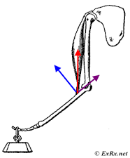
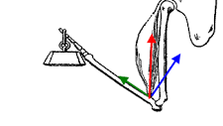
The efficiency is decreased as the angle of pull is reduced or increased, as some of the force is used in pulling the bone of insertion towards the fulcrum joint

Slide 114
Efficiency of Resistance
The effect of resistance will also be maximum when it is applied at right angles to a lever and will decrease as the angle of pull becomes acute or obtuse
Resistance can be applied by physiotherapist’s hand/rope/weight cuffs etc

Slide 115
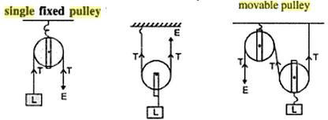
Pulleys
A pulley is a grooved wheel which is rotated about a fixed axis by a rope which passes around it
The axis is supported by a framework or block, and the whole structure may be used either as a fixed pulley or a movable pulley

Slide 116
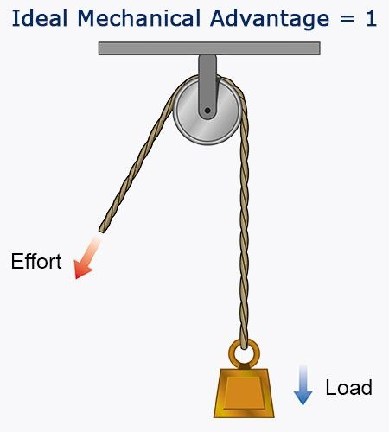
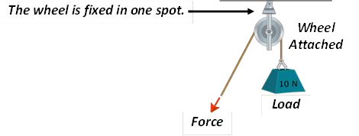
The Fixed Pulley
Used to alter the direction of a force, and enables traction or resistance to be applied at any angle
Pulley block is fixed to some support surface and the rope around the wheel has weight attached to one end and effort is applied at the other end

Slide 117
Movable Pulley:
It is used to get a mechanical advantage when lifting heavy weights
E.g. Lifting the trunk for suspension exercises
Upper pulley is fixed to an overhead support, a rope is attached to one end
The rope is then wound around another movable pulley, to which the weight is attached
Effort is applied at the free end

Slide 118
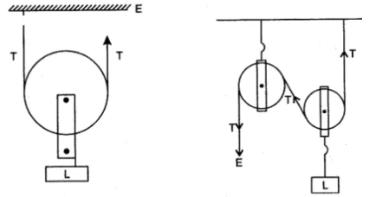

Slide 119
If friction is omitted, tension is the same in all part of the rope
Weight= 6 kg
Tension in two ropes 3kg and the effort (E) required will be 3 kg
Mechanical advantage = W/E = 6/3 = 2
If double pulleys are used the effort required can again be reduced by half

Slide 120
Pendulum

Slide 121
A simple pendulum is a heavy particle, suspended by a weightless thread and free to move to and fro
When at rest- the thread (rope) is vertical, but if the particle (or weight) is drawn to one side and then released, the pendulum will swing to and fro
One complete swing to each side- Oscillation
Extent of swing to any one side from the vertical- Amplitude

Slide 122
Force- required to set the pendulum in motion and to stop the oscillations (or resistance of the air)
Time taken for each oscillation depends on the length of the pendulum

Slide 123
Pendular Movement
In the body, at the shoulder and hip joints when the muscles are relaxed and the limb distal to the joints swings loosely to and fro
Muscle contraction is needed to initiate the movement and to maintain or increase the amplitude
E.g. Leg swing during walking
Arm swinging exercises at natural speed for extreme muscle weakness or when slow/rapid movement is impossible

Slide 124
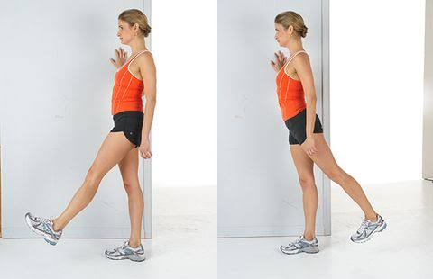

Slide 125
Movement in Axial suspension
A limb, supported by ropes from a point vertically above the joint to be moved, is said to be in axial suspension, i.e. the point of suspension is vertically above the axis of movement
When limb is relaxed- limb with the joint will rest in neutral position
When movement is initiated- it will swing freely to either side of this resting position on a plane which is horizontal

Slide 127
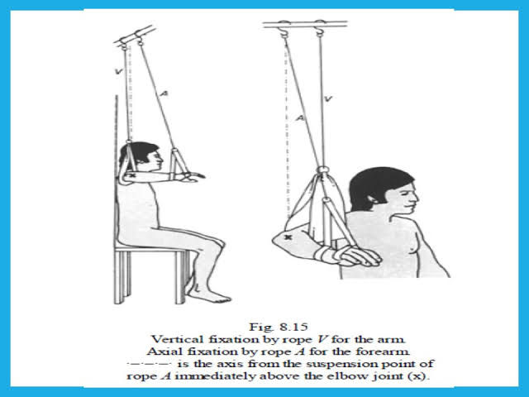

Slide 129
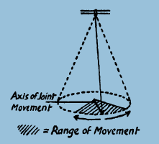
The arc of movement forms a segment of the base of a cone
The radius is equal to the length of the limb
Height is equal to the perpendicular distance between the joint and the point of suspension

Slide 130
Advantage:
Limb is completely supported throughout a wide range of motion
Limb is gravity free/ weightless
Aids relaxation during passive movement and relieves PT from the need to support the patient’s limb

Slide 131
Rhythmical active movement, with a suitable speed, in a pendular character, minimal muscle work required to maintain the pendular character
Promotes relaxation and increases circulation

Slide 132
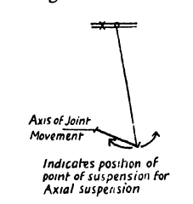
Movement in Pendular Suspension
This type of suspension represents merely a lateral and medial displacement of the point of suspension from the position which it occupies in axial suspension
The joint often achieves new resting positions

Slide 133
Movement on either side of this resting position causes the centre of gravity of the limb to rise, making pendular movement possible
Muscle work required to produce movement away from the resting position is increased but none is required for the return of movement
The foot supported at the center of gravity of the leg acts like a pendulum

